Slide 1

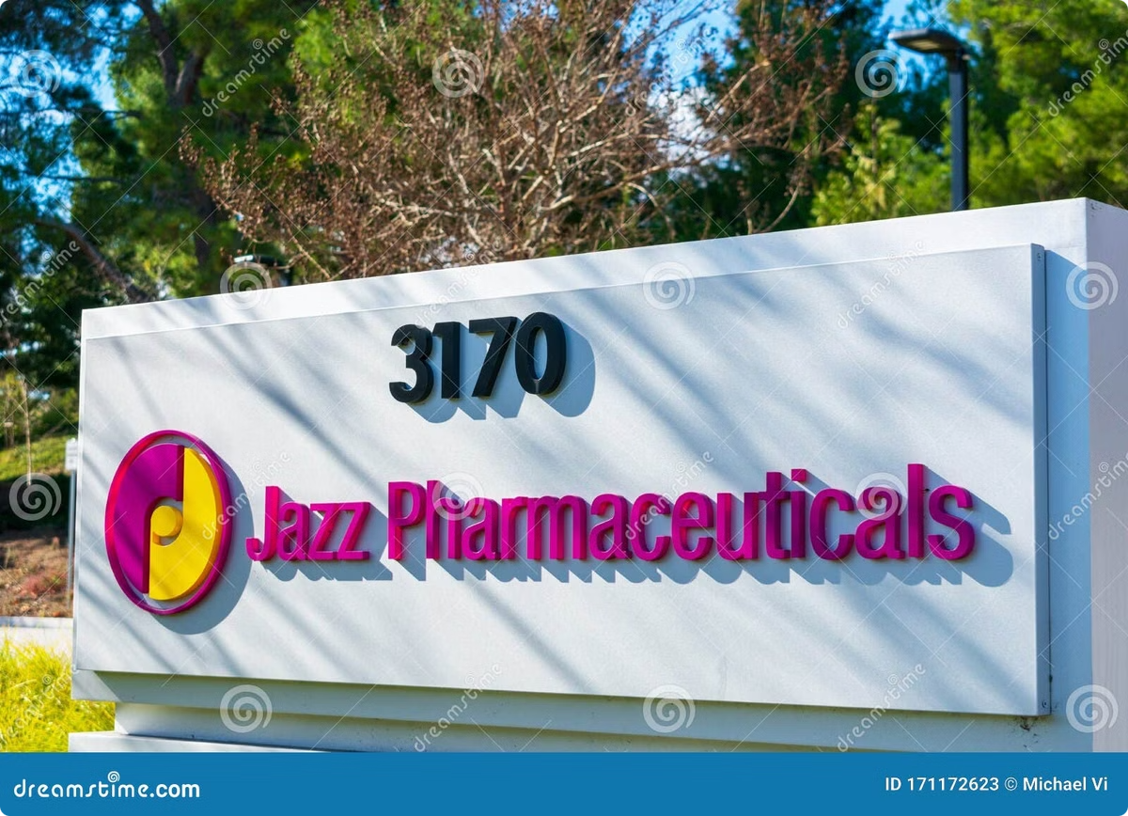
Shorting Jazz Pharmaceuticals
Our analysis indicates that Jazz Pharmaceuticals [JAZZ] is significantly overvalued, presenting a compelling opportunity to short the stock. We expect the share price to decline by 50-70% within the next 6-12 months due to a range of factors discussed in detail below.
By Saquib Uddin Akter

Slide 2
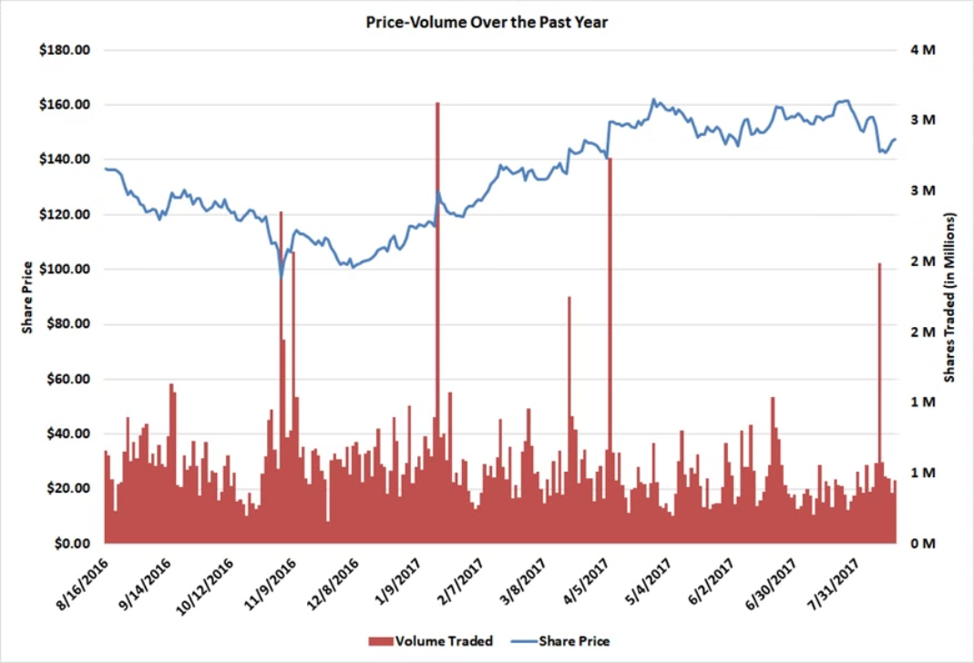
Company Background
Industry
Key Financials
Product Portfolio
Specialty pharmaceuticals, focusing on orphan drugs for narcolepsy, leukemia, and stem-cell complications.
$1.5 billion revenue; $759 million EBITDA. Market cap of $9.1 billion; Enterprise Value of $10.5 billion.
Xyrem (75% of revenue), Erwinaze (~14%), Defitelio (~7%).

Slide 3
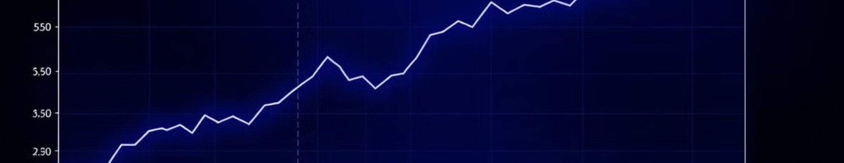
Investment Thesis
1
Xyrem Generics
2
Pricing Power
3
Pipeline Drugs
Generics likely to enter market in FY 20-21, earlier than the market's FY 23 assumption, reducing intrinsic value by ~10%.
Reduced ability to increase prices significantly, limiting revenue growth and reducing intrinsic value by 20-25%.
Vyxeos and JZP-110 unlikely to achieve expected peak sales, lowering intrinsic value by ~20%.

Slide 4
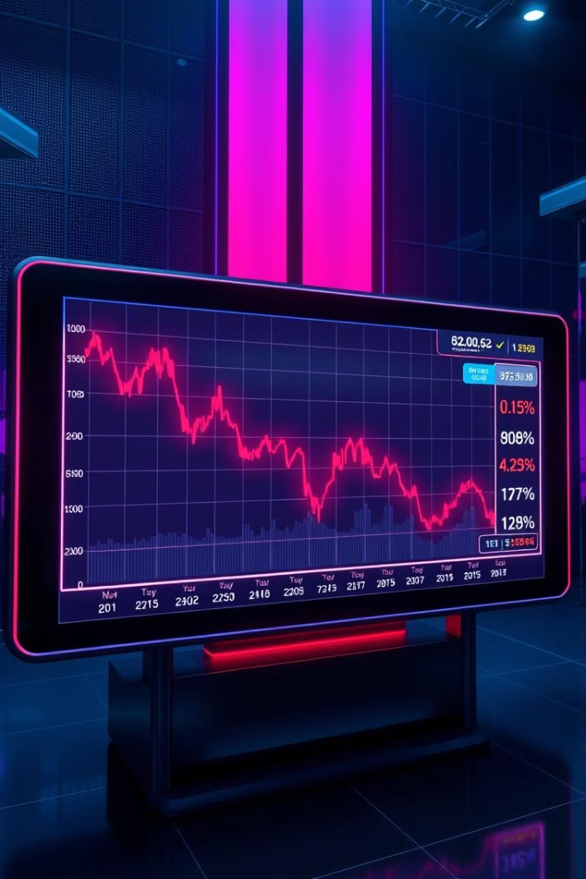
Catalysts
1
Xyrem Generics
Multiple generics companies seeking FDA approval, with potential litigation resolution in the next 12 months.
2
Pricing Pressure
Industry-wide scrutiny on price increases, with Allergan's pledge to limit annual hikes to 10%.
3
Pipeline Underperformance
Early sales results for Vyxeos and JZP-110 could disappoint the market, lowering growth expectations.

Slide 5
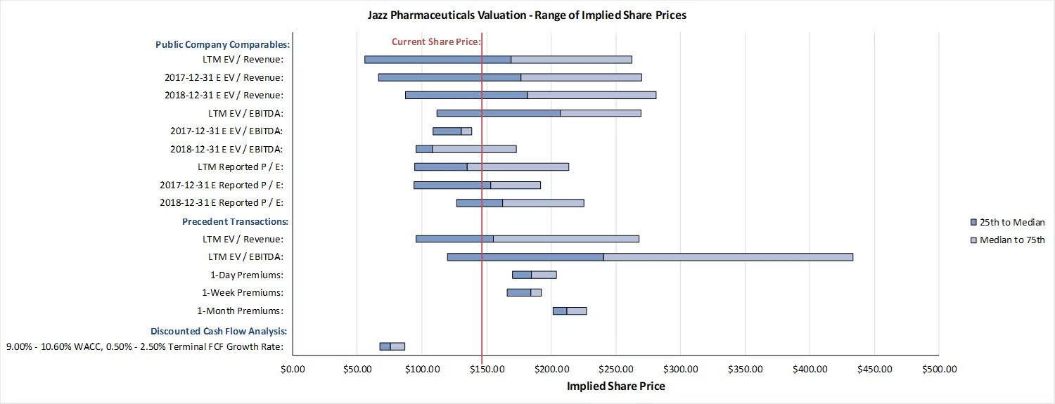
Valuation Summary
Our 10-year DCF analysis, even with optimistic long-term assumptions, indicates that Jazz Pharmaceuticals is overvalued by 50-70% at the current share price of ~$147.

Slide 6
DCF Assumptions
Downside
Base
Upside
Xyrem Peak Sales: $0.2B
Xyrem Peak Sales: $0.3B
Xyrem Peak Sales: $0.3B
Erwinaze Peak Sales: $0.3B
Erwinaze Peak Sales: $0.4B
Erwinaze Peak Sales: $0.6B
Defitelio Peak Sales: $0.3B
Defitelio Peak Sales: $0.4B
Defitelio Peak Sales: $0.6B
Vyxeos & JZP-110 Sales: Modest
Vyxeos & JZP-110 Sales: Moderate
Vyxeos & JZP-110 Sales: Optimistic
Margins: 40% to 25-30%
Margins: 40% to 25-30%
Margins: 40% to 25-30%
WACC: 10.0% to 7.5%
WACC: 10.0% to 7.5%
WACC: 10.0% to 7.5%

Slide 7
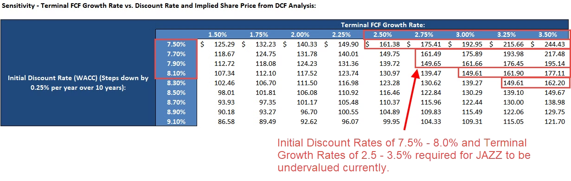
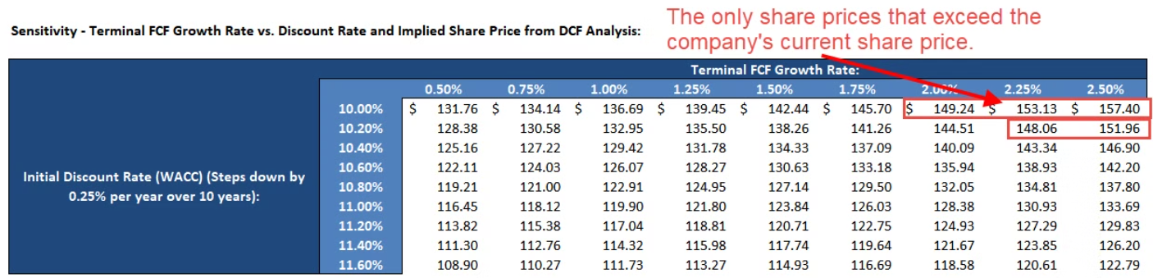
DCF Sensitivities
Even in the Upside Case, the company appears overvalued. The Base Case requires significantly lower discount rates and higher terminal growth for it to be undervalued.

Slide 8
Key Risks
Late Xyrem Generics
Pipeline Outperformance
Early-Stage Drug Potential
FY 23 entrance rather than FY 20-21 could boost share price by ~10%.
Vyxeos and JZP-110 exceeding expectations could raise share price by 15-20%.
Positive data for JZP-258 and JZP-507 could add another 10-15% upside.

Slide 9



Mitigation Strategies
Call Options
Short Xyrem Generics
Biotech/Pharma ETF
Purchase $170-$180 call options to limit losses to 15-20%.
Short competitors like Hikma and Par to hedge Xyrem risk.
Long a broad industry index fund to hedge pipeline and pricing risks.

Slide 10
Recommendation and Summary
1
Short Recommendation
2
Key Catalysts
3
Hedging Strategies
We recommend shorting Jazz Pharmaceuticals as it is overvalued by 50-70% at the current share price of ~$147.
Xyrem generics, pricing pressure, and pipeline underperformance are likely to drive the stock price down in the next 6-12 months.
Investors can use call options, short positions, or a biotech/pharma index fund to mitigate the downside risks.

